Slide 1
Jumpman LCD Game
By: San San Goh

Slide 2
Description
Goal:
allow the user to move the character up and down to avoid obstacle
collect items to boost their score up in order to get through the round without dying
There might be difficulty implemented so it could challenge the user.
A buzzer will sound if the user fails to pass the round.

Slide 3
Potential user
My target audience
is people aged between 15 and 40 years old
Younger users, such as teenagers, may be interested in its simplicity and appeal to them as an introduction to retro games
People aged mid-twenty to 40 may be interested because of the reminiscent of the old nostalgic days of arcade games
In addition, it could be that they are looking for a short round of play because it is an easy-to-pick-up game and doesn't require much time commitment

Slide 4
Requirement
Requirements:
Allowing the charcter to jump, collect items and avoid obstacle [function]
Store information regarding the placement of obstacles, items and layout [data]
Keeping track of the score [function]
LCD screen to display the visual and the buzzer if the user lose the game [usability]
The IDE software used to code the circuit [environemnt]
The components to create the circuit [environment]
Implementing difficulty level [function]
Storing the score [data]
The joystick to change character movement [usability]
Push button to start the game and select difficulty level [usability]
The game gives off a retro nostalgic vibe [context]
The target audience who might be participating in this game [context]
Potentiometer to adjust the contrast of the LCD screen [usability]

Slide 5
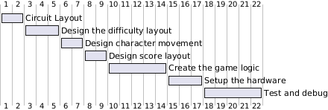
Timing
Gant chart:

Slide 6
Components
Breadboard
LCD screen
Joystick
Buzzer
Arduino Mega
Push button
Resistor
Potentiometer

